Slide 1

Deep Learning With Edge Computing: A Review
J. Chen and X. Ran, "Deep Learning With Edge Computing: A Review," in Proceedings of the IEEE, vol. 107, no. 8, pp. 1655-1674, Aug, 2019.
Professor: Dr. Chih–Yu Wang
Presenter: Shao–Heng Chen
Date: January 5, 2021

Slide 2

Outline
Introduction
Applications of deep learning at the edge
Method for fast inference
Open challenges
Conclusion and Future works
1

Slide 3
I. Introduction
Deep learning is currently widely used, and has been recognized as the state of the art for a variety of application domains.
However, deep learning’s high accuracy comes at the expense of high resources requirements for both the training and inference.
Challenges for cloud computing:
1. Latency
2. Scalability
3. Privacy
2
Notes:
為什麼需要邊緣計算的研究? edge computing跟先前的cloud computing或distributed computing有什麼本質上的區別?
Domains like computer vision, natural language processing, and big data analysis
為了滿足深度學習的計算需求，一種常見的方法是利用cloud computing。而若要使用雲端資源，數據必須從網路邊緣(network edge)的數據源位置(例如，從智慧型手機和物聯網傳感器)移動到雲端(centralized location in the cloud)，而這種將數據從source移到雲端的潛在解決方案帶來了一些挑戰及問題

Slide 4
I. Introduction
While edge computing can provide the latency, scalability, and privacy benefits, several major challenges remain to realize deep learning at the edge.
One major challenge is how to accommodate high resource requirements on less powerful edge compute resources?
Second challenge is how the edge devices should coordinate with other edge devices?
Finally, privacy remains a challenge. Some data still need to be exchanged between edge devices.
3
Notes:
第一個主要挑戰是如何在功能較弱、資源較少的邊緣裝置上滿足深度學習的高資源要求，如算力、通訊、記憶體…等等。
第二個挑戰是了解邊緣裝置在異構處理能力(heterogeneous processing capabilities )和動態網路情況(dynamic network conditions)下應如何與其他邊緣裝置和雲端協調，以確保良好的端到端(end-to-end)應用級性能(application-level performance)。
最後，隱私仍然是一個挑戰，即使邊緣計算通過將數據保留在網路邊緣本地來自然地提高隱私，因為一些數據仍然常常需要在邊緣設備甚至可能和雲端之間交換。

Slide 5
II. Applications of deep learning at the edge
Computer vision: Vigil.
Natural language processing: Amazon Alexa, Apple Siri.
Network functions: intrusion detection and wireless scheduling.
Internet of Things: wearables for healthcare, smart city, smart grid.
AR/VR: Google Glass Gabriel.
4
Notes:
Vigil由無線攝像頭網路組成，這些攝像頭在邊緣節點智慧地選擇影像(幀進)行分析 Vigil邊緣計算的動機有兩個: 與將所有幀上傳到雲端進行分析相比，減少頻寬消耗，以及可隨攝像機數量的增加實現擴展性
IoT實時分析物聯網傳感器數據並不總是必要的，並且來自傳感器的通訊頻寬要求通常很小(除非涉及影像)，就目前來看隱私是推動物聯網邊緣處理的主要問題

Slide 6
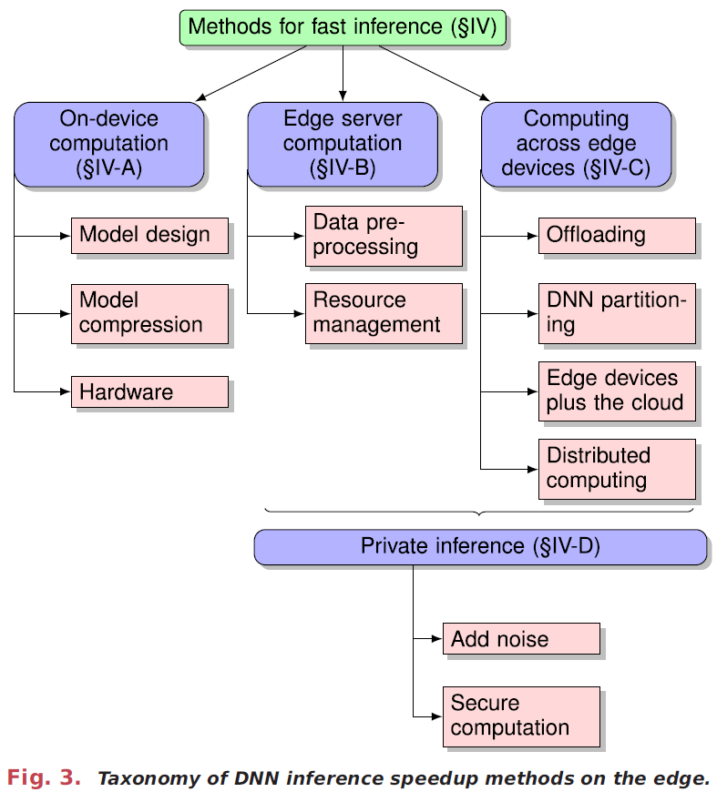
III. Method for fast inference
There are three major architectures
A. On-device computation
B. Edge server-based architectures
C. Joint computation across edge devices
5
Notes:
討論圍繞三個主要架構的研究:
1)邊緣裝置(on-edge)上計算，其中 DNN 在終端設備上執行；
2)基於邊緣伺服器(edge-server based)的架構，來自終端設備的數據被發送到一個或多個邊緣伺服器進行計算；
3)邊緣裝置、邊緣服務器和雲端之間(joint computation among end devices, servers, and the cloud)的聯合計算。
此外還討論數據在邊緣裝置和雲端之間通訊時的隱私保護技術

Slide 7
III. Method for fast inference
A. On-Device Computation
1) Model Design: SqueezNet(4.9 MB), MobileNet(16.9 MB), Tiny-YOLOv3(55.9 MB).
2) Model Compression: parameter quantization, parameter pruning, and knowledge distillation.
3) Hardware: ASIC, FPGA-based DNN accelerators.
6
Notes:
參數量化採用現有的DNN，並通過從浮點數變為低位寬數(low-bit width numbers)來壓縮其參數，從而避免代價高昂的浮點乘法。
修剪也是採用現有的DNN去除最不重要的參數
知識蒸餾是創建一個較小的DNN，以模仿更大、更強大的DNN 的行為

Slide 8
III. Method for fast inference
B. Edge Server Computation
1) Data Preprocessing, reduce data redundancy and thus reduce communication overheads.
2) Edge Resource Management, DNN tasks from multiple end devices need to run and be efficiently managed on shared compute resources.
7
Notes:
當 DNN 在邊緣服務器上運行時，來自多個邊緣設備的 DNN 任務需要在共享計算資源上運行和有效管理
2) focusing on the tradeoffs between accuracy, latency, and number of requests served

Slide 9
III. Methods for fast inference
C. Computing Across Edge Devices
Four offloading scenarios:
1) binary offloading, whether offloading the entire DNN or not?
2) partial offloading, what fraction of computation should be offloaded?
3) hierarchical architectures, how to offload across devices, server, and cloud?
4) distributed computing, how to offload across peer devices?
8
Notes:
討論四種卸載場景:
1) DNN二元卸載，決定是否卸載整個DNN；
2) DNN部分卸載，其中決定是否應該卸載DNN計算的哪一部分；
3) 跨邊緣設備、邊緣伺服器和雲端的組合執行卸載的分層架構；
4) 分佈式計算方法，將DNN計算分佈在多個對等設備上

Slide 10
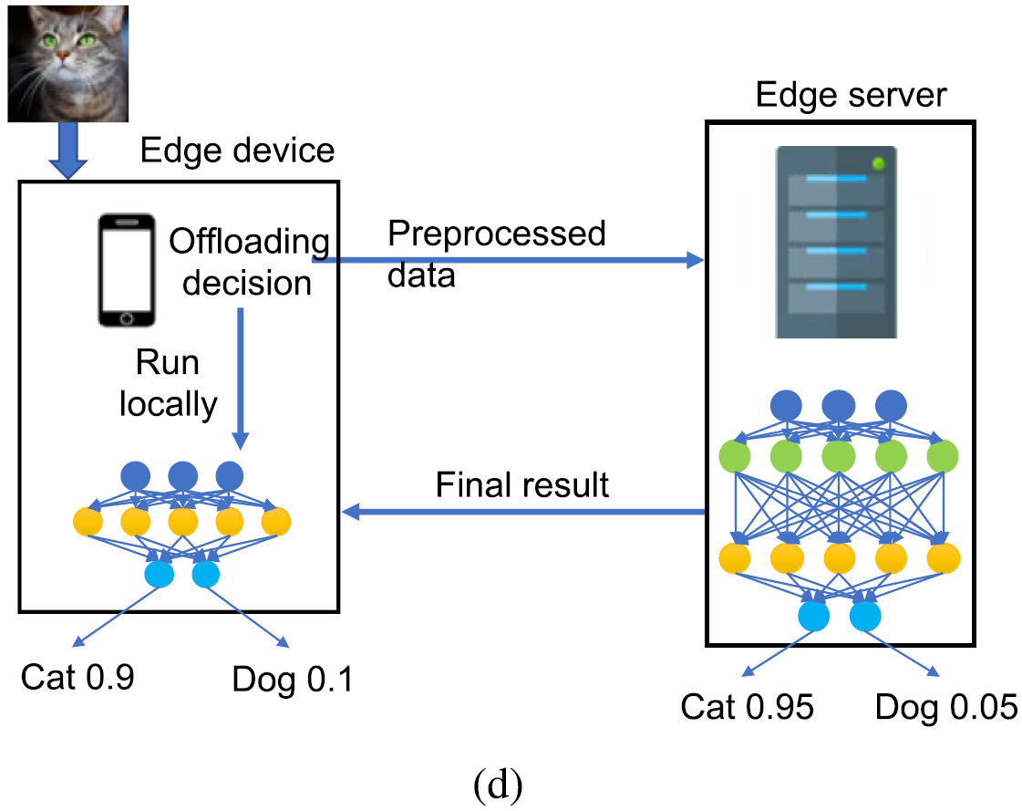
III. Methods for fast inference
C. Computing Across Edge Devices
1) Offloading: DeepDecision and MCDNN, both are optimization-based offloading approach.
9
Notes:
1) Multi-Column CNN, 這些決策基於對這些參數之間權衡的經驗，例如不同 DNN 模型的能耗、準確性、延遲和輸入資料大小
The catalog of different DNN models: existing popular models or new model variants constructed through knowledge distillation or by “mix-and-matching”
是否卸載的決定取決於數據的大小、硬件能力、要執行的 DNN 模型以及網路品質等因素

Slide 11
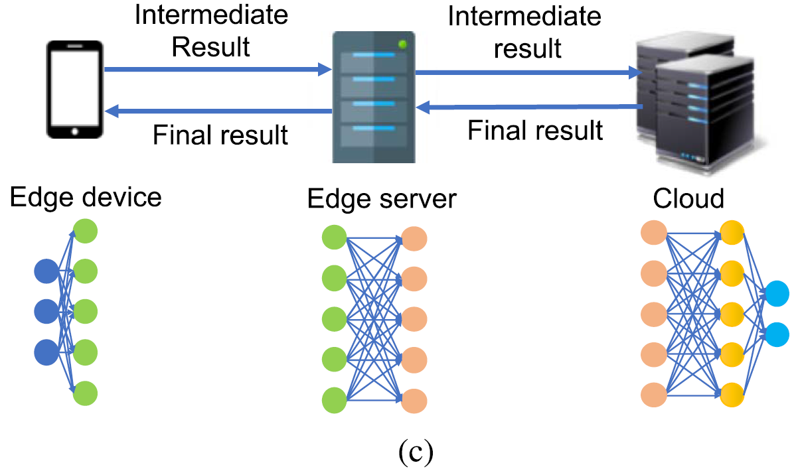
III. Methods for fast inference
C. Computing Across Edge Devices
2) DNN Model Partitioning, some layers are computed on the device, and some layers are computed by the edge server.
3) Edge Devices Plus the Cloud
10
Notes:
2)除了按層對 DNN 進行分區外，DNN 還可以按輸入維度進行分區
3)雖然單獨卸載到雲端可能會違反所考慮的深度學習應用程序的實時要求

Slide 12
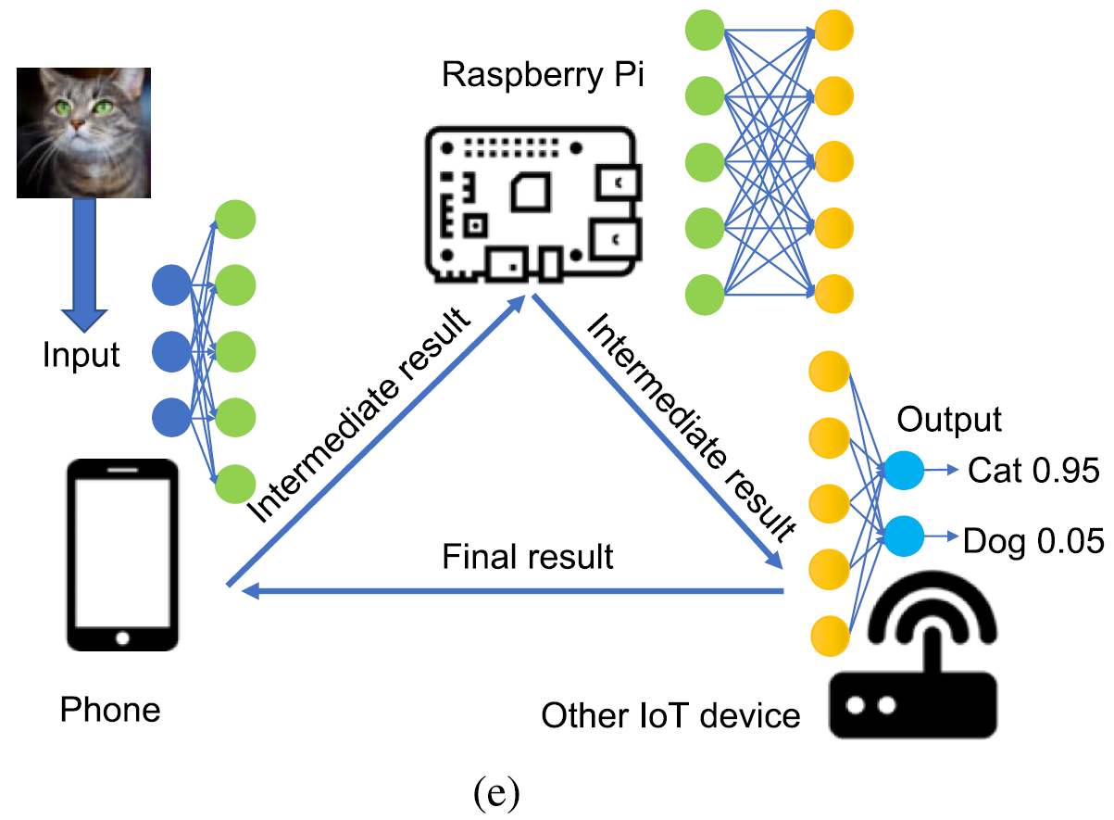
III. Methods for fast inference
C. Computing Across Edge Devices
4) Distributed Computation, computations can be distributed across multiple helper edge devices.
11
Notes:
4) MoDNN, DeepThings DNN分區決策是基於邊緣設備的計算能力和/或記憶體。在運行時 輸入數根據負載平衡原則分發 以考慮計算資源可用性或網路條件的動態變化

Slide 13
III. Methods for fast inference
D. Private Inference, data from the end devices may contain sensitive information (e.g., GPS coordinates, camera images, and microphone audio), leading to privacy concerns.
1) Add Noise to Data, to ensure differential privacy.
2) Secure Computation: Cryptographic techniques, Homomorphic encryption, Multiparty computation.
12
Notes:
1) 保護user data, guarantees a model does not remember details about any specific device’s input data
2) 保護user data跟server 確保邊緣設備在不了解 DNN 模型的情況下接收推理結果，並且邊緣服務器在不了解設備數據的情況下處理數據
Low-degree多項式來逼近 DNN 中使用的常見計算
安全多方計算側重於計算中間步驟的隱私，而差分隱私則側重於整體構建模型的隱私保證

Slide 14
IV. Open Challenges
A. System Challenges: Latency, Energy, Migration.
B. Management and Scheduling of Edge Compute Resources: tradeoff and priority
C. Deep Learning Benchmarks on Edge Devices: standard hardware, dataset, and machine learning platform.
D. Privacy, membership attacks and data obfuscation.
13
Notes:
A. Migration當用戶移動時 深度學習應用程式應該如何遷移
B. Tradeoff between latency, accuracy, battery 來自設備 A 的第 1幀的請求是否應該比來自設備 B 的第 100 幀更優先? Priority?
D. 用戶集更小，深度學習模型更專業 more specialized deep learning models

Slide 15
V. Conclusion and Future works
Many open challenges remain, both in terms of further performance improvements, as well as privacy, resource management, benchmarking, and integration with other networking technologies.
DNN model and computation can be divided layer-wise, input-wise, or possibly in other ways yet to be explored. Maybe we could design a channel-wise approach that could dynamically reallocate the resources base on the channel condition.
14
Notes:
本文回顧了深度學習在網路邊緣運行的當前技術水平 描述了跨邊緣設備 伺服器和雲端加速深度學習推理的方法

